Slide 1
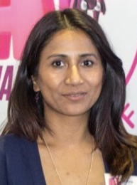
Moving Forward with AI
Optimising your business
Lee Chana, AI in Africa
connect@aiinafrica.org
Lee@fliptin.com

Slide 2
We design Interventions that bridge the gap in education and prepares people for 21st century jobs

Slide 3
YOUR BUSINESS
Your biggest problem today
If you were to project yourself in 5 years time, what’s your vision for your company?

Slide 4
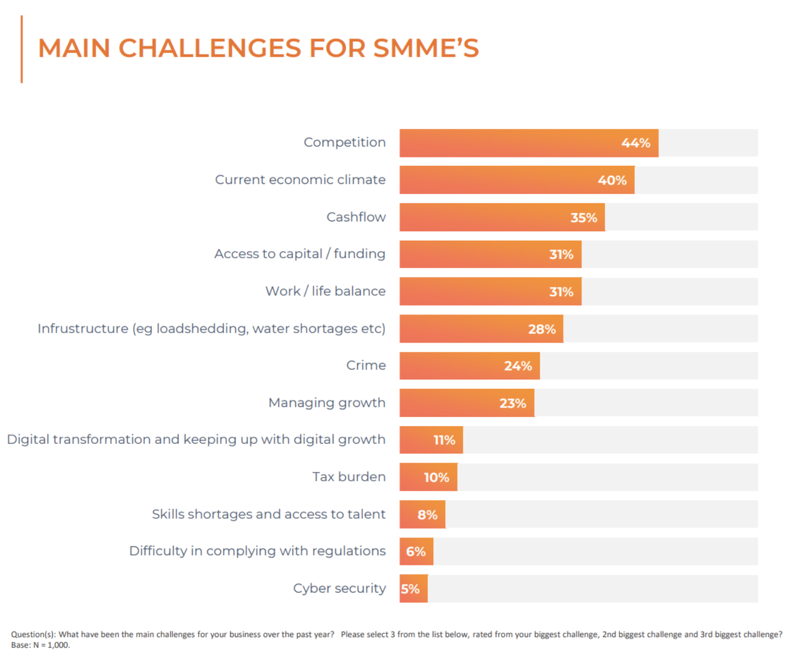
infoQuest
https://businesstech.co.za/news/business/758653/the-biggest-problem-for-small-businesses-in-south-africa-and-its-not-load-shedding/
Notes:
https://businesstech.co.za/news/business/758653/the-biggest-problem-for-small-businesses-in-south-africa-and-its-not-load-shedding/

Slide 5
CUSTOMER SERVICE
Example: A small e-commerce store can implement a chatbot on its website to assist customers with order tracking, product information, and returns. This not only improves customer satisfaction but also frees up human agents to tackle more complex issues
Tools:
Zendesk: An AI-powered customer service platform that offers chatbots and automated ticketing systems to streamline customer support.
LivePerson: Provides conversational AI solutions that help businesses engage with customers through messaging platforms.
Intercom: An AI-driven customer messaging platform that offers automated responses and personalized communication.
ChatGPT: an AI language model designed to understand and generate human-like text. It's great for customer support, providing a conversational interface for answering FAQs or addressing customer queries.

Slide 6
MARKETING STRATEGIES
Example: An AI-driven email marketing platform can segment a customer base based on behavior and preferences, sending tailored promotions that increase engagement and conversion rates.
Tools:
HubSpot: An inbound marketing and sales platform with AI capabilities for customer segmentation, lead scoring, and personalized email campaigns.
Mailchimp: Offers AI-driven insights to optimize email marketing campaigns, including predictive analytics for customer behavior.
Hootsuite Insights: Uses AI to analyze social media trends and customer sentiment, helping businesses tailor their social media strategies.
ChatGPT, Google Bard,

Slide 7
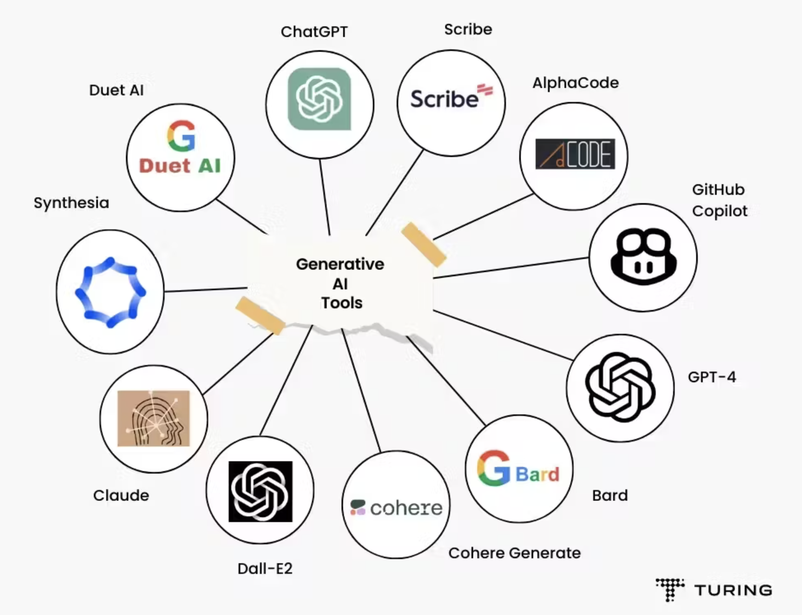
GENERATIVE AI
Generative AI is a type of AI that can generate text images, videos, and other content in response to a user prompt based on its training data. ChatGPT is an example of a text-based generative AI solution.
Content creation (marketing , comms, templates, documents)
Design and art
Software development (code snippets)
Language translation
Finance
Gaming
Healthcare
https://www.turing.com/resources/generative-ai-tools
https://www.facebook.com/groups/aitoolsmidjourneychatgpt
Notes:
https://www.turing.com/resources/generative-ai-tools

Slide 8
SALES PERFORMANCE
Example: A CRM system equipped with AI can remind a sales team to follow up with a lead at the optimal time, suggest the most effective communication channels, and even provide personalized product recommendations based on previous interactions. Tools:
Salesforce Einstein: An AI-powered CRM that provides predictive analytics, automated data entry, and personalized recommendations to enhance sales processes.
Pipedrive: A sales management tool with AI features that help identify high-potential leads and optimize sales activities.
Zoho CRM: Uses AI to analyze sales data, predict outcomes, and provide actionable insights to sales teams.
Hubspot: a CRM platform that can help simplify processes across marketing sales and customer support.

Slide 9
STREAMLINE OPERATIONS
Example: An AI-driven inventory management system can predict stock levels based on historical data and trends, ensuring that the right amount of inventory is available at all times. This helps avoid overstocking or stockouts, saving both time and money.
Tools:
Xero: An accounting software with AI capabilities that automate invoicing, expense tracking, and financial reporting.
Odoo: An open-source ERP system with AI features for inventory management, procurement, and order processing.
UiPath: Provides robotic process automation (RPA) to automate repetitive tasks across various business functions.
Notes:
https://www.linkedin.com/pulse/where-you-your-ai-journey-the-learning-and-performance-insti-ddzve/

Slide 10
DECISION MAKING
Example: An AI-powered analytics platform can help businesses understand which products are performing best in different regions, allowing for strategic decisions regarding inventory distribution and marketing efforts.
Tools:
Tableau: A business intelligence platform that uses AI to analyze and visualize data, helping businesses make informed decisions.
Power BI: Microsoft’s AI-powered analytics tool that provides interactive data visualizations and business intelligence capabilities.
Qlik Sense: Uses AI to deliver data analytics and insights, enabling businesses to discover trends and make data-driven decisions.

Slide 11
YOUR BUSINESS
Your biggest problem today
If you were to project yourself in 5 years time, what’s your vision for your company?
If you were to project yourself in 5 years time, what’s your vision for your company with AI?

Slide 12
GETTING STARTED WITH AI
Notes:
I invite you to join us.
To think of a different Africa. To create a different Africa. To leave a mark, and a better world!
Walking around here earlier, I came across rebels, makers, movers and shakers!
And although you introduced yourself warmly, by name, the organization you represent and how you’re linked to EDF, I wonder,
..what is your dream; and what will be your legacy?
And how can we -as AI in Africa, and our large pool of problem solving champions in our range- help you build it?

Slide 13
YOUR AI JOURNEY
Know your data!
Identify Pain Points: Determine the areas in your business where AI can have the most impact.
Research AI Tools: Explore AI tools that cater to your specific needs. Many platforms offer scalable solutions tailored to SMBs.
Pilot Projects: Implement AI in a small, manageable part of your business to test its effectiveness.
Monitor and Adjust: Continuously monitor the performance of AI tools and make adjustments as needed to maximize their benefits.

Slide 14
PRACTICAL TIPS
DO
Invest in training
Start small
Keep the human touch
DON’T
Don’t ignore data security and privacy
Don’t forget about maintenance
Don’t expect immediate results

Slide 15
Thank you.
Aiinafrica.org I connect@aiinafrica.org | Lee@fliptin.com
Notes:
I invite you to join us.
To think of a different Africa. To create a different Africa. To leave a mark, and a better world!
Walking around here earlier, I came across rebels, makers, movers and shakers!
And although you introduced yourself warmly, by name, the organization you represent and how you’re linked to EDF, I wonder,
..what is your dream; and what will be your legacy?
And how can we -as AI in Africa, and our large pool of problem solving champions in our range- help you build it?

